Slide 1
Climate Center Energy & Water
10/14/21

Slide 2
AGENDA
CCA & CCCE OVERVIEW
PATHWAY TO 100% RENEWABLE
ENERGY PROGRAMS
UNDERSERVED COMMUNITY OUTREACH

Slide 3
How Does CCA Work?
“A Partnership to support shared customers”
Notes:
Assembly Bill 117, passed in 2002, established CCAs. CCAs offer an opportunity for communities to join together to choose the source of their electricity.
3CE buys power for its collective ratepayers and it is delivered over existing transmission lines as a cleaner, competitive alternative to your existing utility.
A city or county joins Central Coast Community Energy to gain more control over its electricity needs and provide economic and environmental benefits to the community.
3CE procures the energy, which is delivered via PG&E’s transmission and distribution lines to you, the customer.
3CE is one of 13 CCAs that collaborate with PG&E this way.
By 2021, 50% of customers in the State of California will be served by CCAs.
Revenue generated by 3CE stays local - and helps keep electricity rates lower for our customers, while also funding energy program.

Slide 4
Notes:
Local governments in more than 200 cities, towns and counties throughout California have chosen to participate in Community Choice Aggregation (CCA)
Meet climate action goals, provide residents and businesses with more energy options, ensure local transparency and accountability, and drive economic development.
There are 22 CCA’s in California

Slide 5
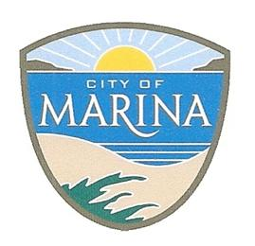
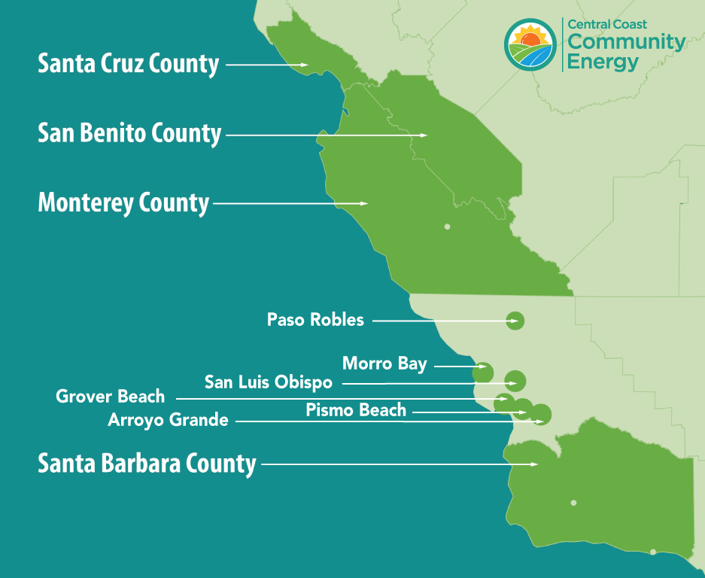
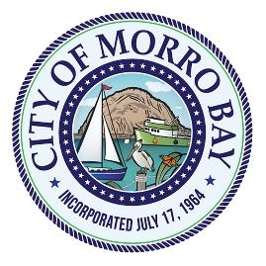
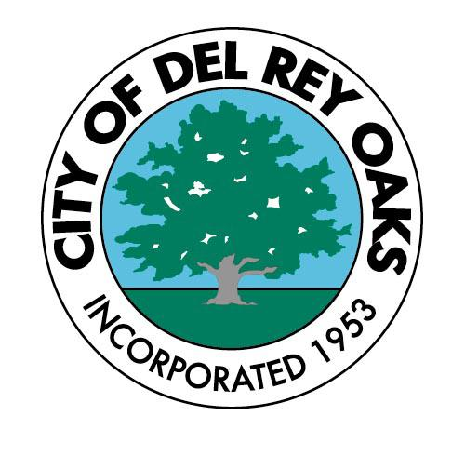
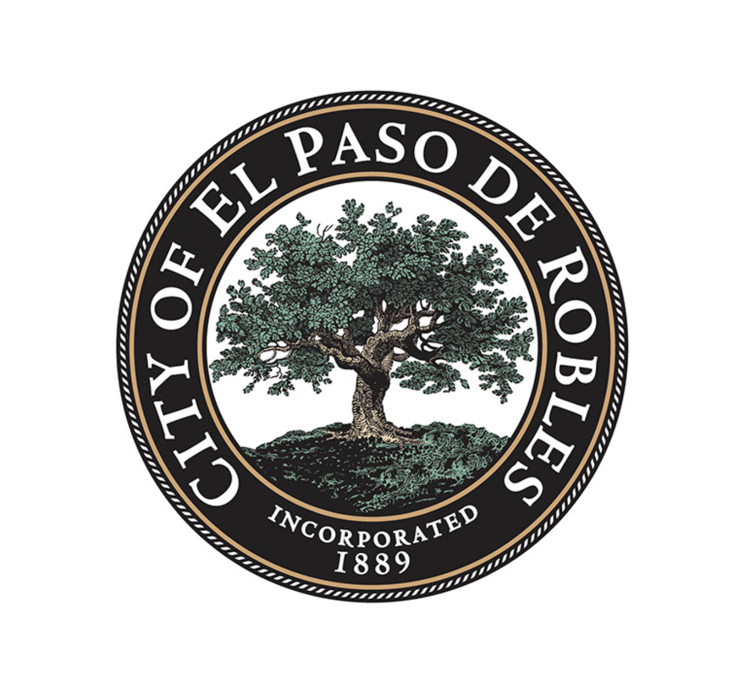
WHO WE ARE?
Notes:
Started service March 2018
33 cities and counties making up
Over 440,000 customers by January 2022
Total retail load consumption is estimated at 5,118 GWh
Successful enrollment of 3 jurisdictions in October 2021 (SCE Service Territory):
Carpinteria
Goleta
Unincorporated Southern Santa Barbara County
Enrollment of the City of Buellton in January 2022 (PG&E Service Territory)

Slide 6
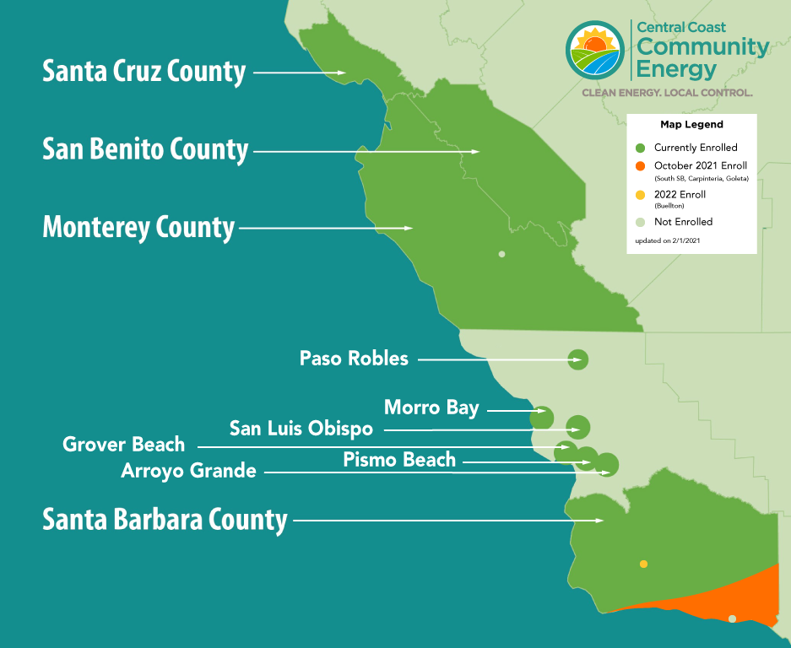
Upcoming Expansion
Over 440,000 customers by January 2022
Total retail load consumption is estimated at 5,118 GWh
Successful enrollment of 3 jurisdictions in October 2021 (SCE Service Territory):
Carpinteria
Goleta
Unincorporated Southern Santa Barbara County
Enrollment of the City of Buellton in January 2022 (PG&E Service Territory)

Slide 7
CCCE GOVERNANCE
Policy Board: Meets 4 Times Annually including Annual Meeting
Operations Board: Meets 10 Times Annually including Annual Meeting
Community Advisory Council: Meets 7 Times Annually including Annual Meeting
County of Santa Cruz
City of Santa Cruz
City of Watsonville
County of Monterey
City of Salinas
County of San Benito
County of Santa Barbara
City of Santa Maria
Coastal Cities Marina*
Sand City
Seaside
Del Rey Oaks
Peninsula Cities Carmel
Monterey*
Pacific Grove
Salinas Cities Greenfield
Gonzales*
Soledad
San Benito Cities Hollister
San Juan Bautista*
Santa Cruz Cities Capitola
Scotts Valley*
San Luis Obispo Cities San Luis Obispo*
Morro Bay
Paso Robles
South County Cities Arroyo Grande
Grover Beach*
Pismo Beach
SB County Cities Guadalupe*
Solvang
Buellton
SB County Cities
Goleta*
Carpinteria
*City representative currently serving in a shared seat.

Slide 8
CCCE Accomplishments
Local Choice
Clean Energy
Financial Stability
Economic Vitality
Local Support
3Cchoice-clean and renewable offering
95% enrollment
$12 million – Energy programs​
Est. $50 million – Customer savings
$25 million – Resiliency Fund
Contracts with Local Vendors
​38 full time employees
2 offices – Monterey & San Luis Obispo
​450 MWs of Renewables – solar, wind, geothermal
200 MWs of battery storage
Pathway to 100% clean and renewable
Received “A” Rating from S&P
​Over $140 Million in Rate Stabilization Fund
Service and Loans Paid Off​
Notes:
Local Choice - 95% enrollment – 97% of ag accounts
38 full time local employees, 2 offices
$12 million energy programs
$50 million in customer savings
A rating from S&P

Slide 9
Photo Credit: 2020 Rutgers, The State University of New Jersey
Notes:
Our goal is clearly stated, we want 100% of our energy to come from clean and renewable sources by 2030.
- Building infrastructure
Most affordable rates
Access to clean energy
Zero Emissions
3CE is committed to purchasing clean and renewable energy at competitive prices on behalf of our member agencies.
3CE has invested 1.4 billion $ into long term renewable energy contracts.
As you can see from the chart, we currently have 8 contracts in our portfolio from various sources of energy.
These contracts are long-term agreements most of which are 15 years or longer and will start coming online by next year.
These contracts will help us reach our goal of 100% clean and renewable by 2030.

Slide 10
School Bus Electrification - $1 million - OCTOBER 2021
Agriculture Electrification - $600k - OCTOBER 2021
Residential Electrification - $1.6 million
Battery Energy Storage Pilot - $350k
Reach Code - $60k
New Construction Electrification - $1.5 million – OCYOBER 2021
Energy Education, Workforce Development and Innovation Grants - $1 million
Summer Readiness - $400k
Greenhouse Gas Inventory - $64k
Electrify Your Ride - $2.8 million – NOVEMBER 2021
FY 21/22 Energy Programs
CCCE Energy Programs
Overview:
4% of operating revenue in FY 21/22
$1.3 million in FY 18/19
$5.4 million in FY 19/20
$6.2 million in FY 20/21
Estimated $14.1 million in FY 21/22
Electrification in building and transportation sectors could result in $3 billion of untapped revenue market wide

Slide 11
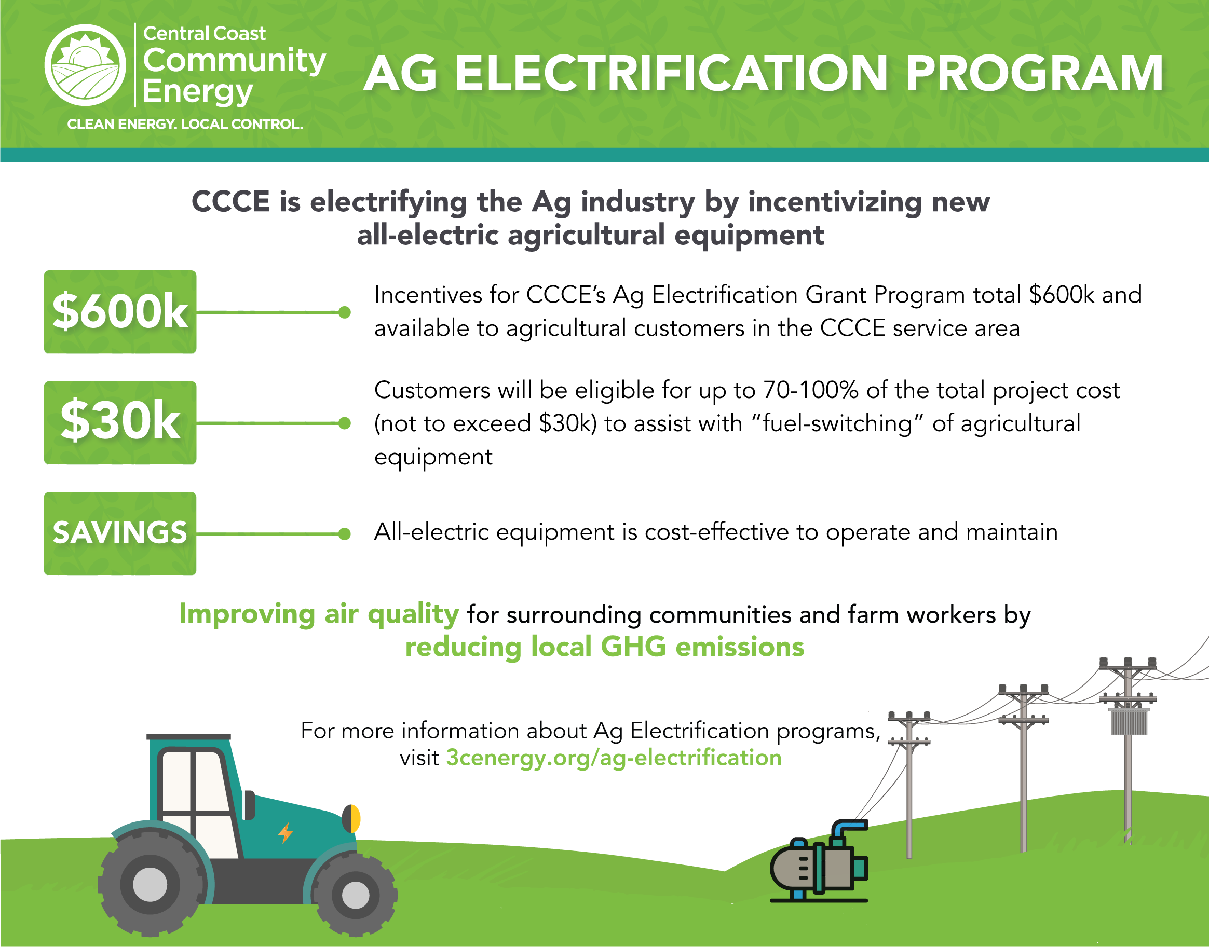
Notes:
Program Impact:
9 Ag customers participated in FY 19/20 program
28 Ag customers participated in FY 20/21 program
Total CCCE incentives: $560K
Total local economic impact: $1.5MM

Slide 12
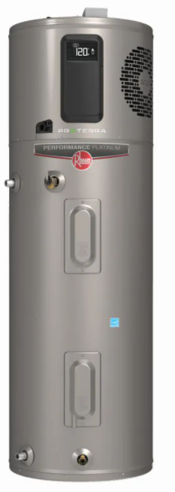
Building Electrification Programs
Residential Electrification Program
Provides rebates to residential customers who switch out fossil-fuel powered water heating, space heating, and cooking equipment with all-electric equipment
Integrates program implementation services including technical assistance, an integrated online marketplace, contractor recruitment, and installation support
Total program budget is $2,050,000
New Construction Electrification Program
Provides affordable housing developers with incentives to build all-electric housing
Total program budget is $1,500,000
Reach Code Incentive Program
Provides incentives to member agencies to adopt/codify electrification reach codes that promote building electrification and/or electric vehicle infrastructure
Total program budget is $60,000

Slide 13
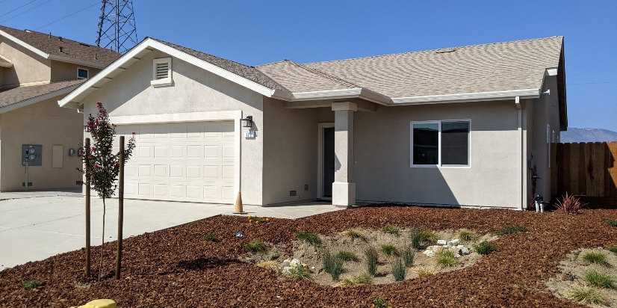
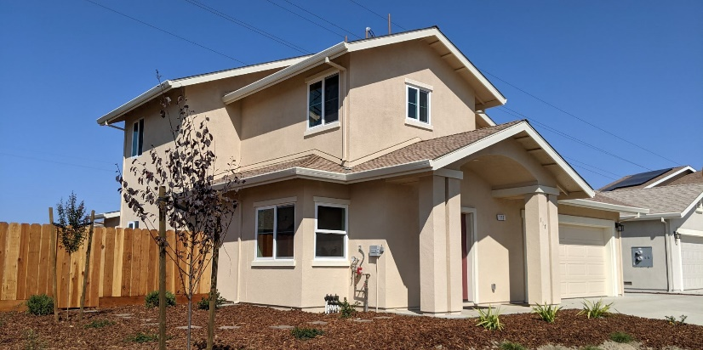
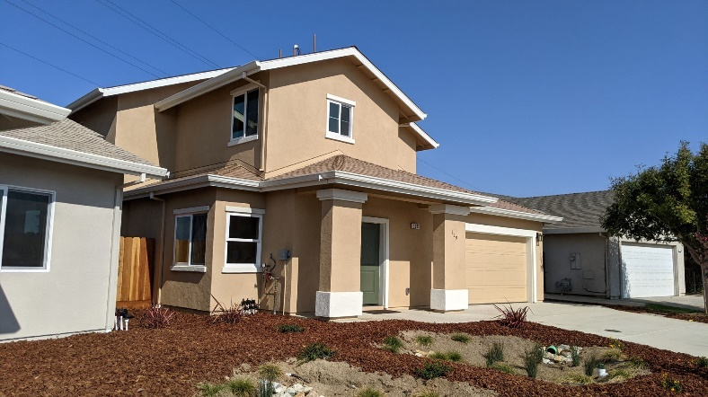
New Construction Electrification Program
“We were pleased that CCCE helped CHISPA finance our all-electric homes. We have seen that today’s electric ranges and water heaters are much more efficient than even just a few years ago. The response time on hot water to faucet is twice as fast as for gas elements.”
- Luis Ortega, CHISPA Construction Superintendent for Rancho San Vicente homes
“It was encouraging to have local funding for our all-electric construction. Now that we know how easy it is to apply and communicate with CCCE, we look forward to replicating this relationship in our next apartment building development.”
- Dana Cleary, CHISPA Director of Real Estate Development

Slide 14
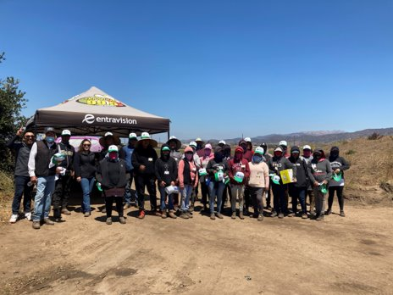
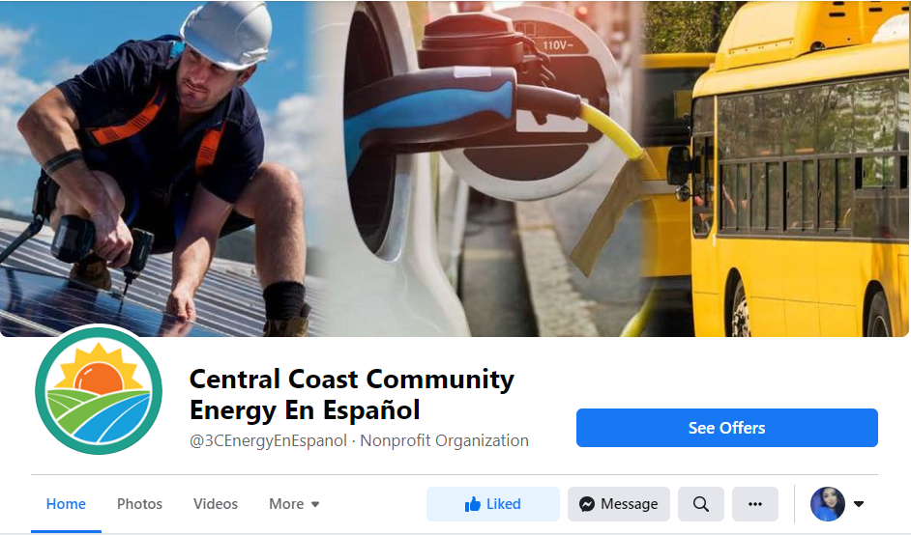
LOCAL OUTREACH & ENGAGEMENT
Farm Worker Outreach
•10 Farm Worker Outreach events in 2021
•Sponsoring La Tri-Color & La Ley radio stations events
•Educate on CCCE services & programs in person
Underserved Community Outreach
•Presentations to stakeholders & organizations
•Latino Elder Outreach Network
•Promotores
•Lideres Campensinas
•Mexican Consulate
•Public Engagement Team & Community Advisory Council created a committee to improve outreach to;
•Low-income, food insecure, renters, senior citizens w/ fixed income, tribal & migrant indigenous communities

Slide 15
Stay Connected with CCCE
www.3Cenergy.org
info@3CE.org
1.888.909.6227 @3CEnergy
@3CEnergy
@3CEnergyEnEspanol
Follow us online, join our newsletter and board agenda notification list, and check our extensive FAQ section on the website.

