Slide 1
The Path to a Resilient Future:
Policy & Commercialization of
Distributed Energy Resources
Allie Detrio
Manager of Policy, ENGIE
Business of Local Energy Symposium
June 21, 2019

Slide 2
ENGIE’s 3D Mission
Decarbonization
  GHG emissions reduction
  Environmental and public health benefits
Decentralization (Diversification)
  Physical and societal risk mitigation
  Financial risk management
  Demand reduction and on-site peak load management
Digitization
  Incentivize and encourage innovation and technological advancement
  Integration of new technologies into the grid for greater efficiency and cost reduction
Distributed energy resources (DERs) deployment at scale is paramount to mitigating risk, ensuring safety, and increasing climate resiliency for our local communities and constituents.
Notes:
How does the 3D mission relate to our discussion? It is a strategy for resiliency and sustainability.
Microgrids:
200+ MW installed
District Energy:
230 operational systems
Customer profiles
Commercial & industrial
Campuses
Critical facilities
Rural electrification
Island and remote community energy self-sufficiency
*Coming soon*
Community resiliency and emergency preparedness
De-energization event planning & management

Slide 3
Demystifying Resiliency
Resiliency is a hot topic for policymakers and utilities nationwide
  Microgrids, critical infrastructure, grid security, emergency preparedness
  How to commercialize advanced DER, controls, and protection technology at scale?
Elements of resiliency as it related to the electric grid:
  Prevention
  Recovery
  Survivability
Challenge: How do we value resiliency?
Notes:
How does the 3D mission relate to our discussion? It is a strategy for resiliency and sustainability.
Resiliency is a hot buzz word being thrown around but what des it really mean? Before I jump into the policy, want to frame this discussion around resiliency.
Prevention
Will require changes in design standards, construction guidelines, maintenance routines, inspection procedures, and emergency preparedness
Recovery
Proper planning for natural disasters and outages, response time, rapid damage assessment, crew deployment to damaged assets, readily available replacement equipment for grid restoration
Survivability
Ability to maintain some basic level of electrical functionality to individual customers or communities in the event of a disaster and complete loss of electrical service from distribution system
The challenge- how do we value resiliency?
DERs and microgrids require comprehensive valuation to fully realize their system potential and public benefits
To date, California has not enabled DERs to maximize their capabilities and fully account for the complete value these resources provide

Slide 4
Resiliency & Beyond: The Value of DERs
DERs and microgrids can address multiple challenges/opportunities
Ensure predictable costs and savings
Increase reliability and enhance power quality
Fix charges
In many cases distributed energy sources will be cheaper than buying electricity from the grid
Flexible resources can reduce the power component of your bill
Energy storage and advanced control systems allow you to ride through blackouts and brownouts, allowing for enhanced system reliability
Advanced control systems will improve
your power quality, deferring associated capital investments
Power charges
Energy charges
ct/kWh
Current Scenario
New Solution
Limit exposure to energy tariff fluctuations
Improve environmental performance
Generating energy on-site can limit your exposure to variable electricity prices or tariff structures
Achieve environmental compliance requirements
Integrating renewable energy
into your system allows you to meet sustainability targets
Ct/kWh
620* ton_{coal}/year
1,183* ton CO₂/year
Time
*Environmental benefit of a 15% renewable energy solution for a 1 MW average load industrial client
Grid price
Your Price
Notes:
Microgrids:
200+ MW installed
District Energy:
230 operational systems
Customer profiles
Commercial & industrial
Campuses
Critical facilities
Rural electrification
Island and remote community energy self-sufficiency
*Coming soon*
Community resiliency and emergency preparedness
De-energization event planning & management

Slide 5
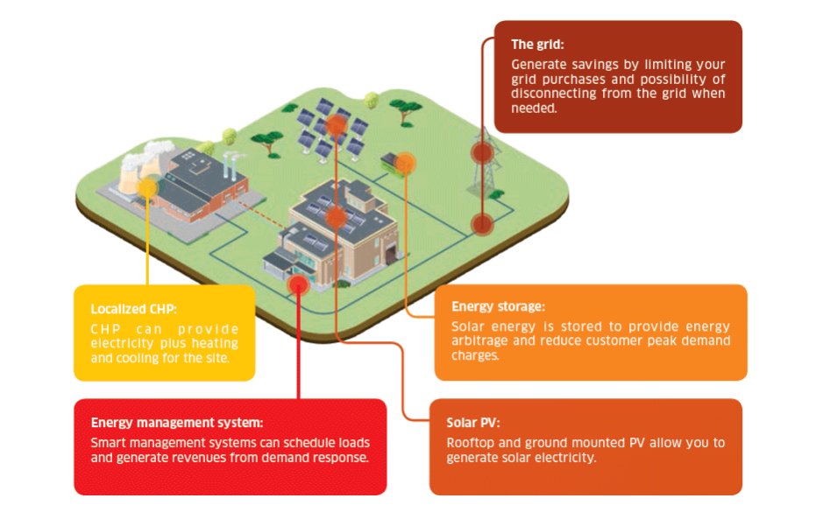
How to make the 3D-Resilient energy future a reality?
Notes:
In Toulouse, the Group has installed and commissioned its Smart ZAE, the first French microgrid developed to serve an entire business park. This grid generates green energy from multiple synchronized sources, and uses chemical and mechanical storage technologies within a system that is stable, financially optimized and synchronized with the national grid using a control and management system

Slide 6
Market-based policy solutions for resiliency
Develop strong price signals for customer and third-party owned DERs
  Will direct private sector investment and innovation in solutions that align with public policy goals
Encourage wide market participation with a diversity of participants
  Minimize single entity ownership/management of non-monopolistic functions and infrastructure
Provide flexibility in regulatory process and administrative guidelines
  Reduce time-consuming project approval processes
  Minimize onerous customer and developer requirements, interconnection and construction guidelines while maintaining public safety
Capture full value of DER capabilities and benefits
  Grid support services
    Address interconnection and rate design
  Societal and non-energy benefits
    GHG emissions reduction, energy education and community engagement, public health and resiliency
Notes:
The market will respond in a manner consistent with state policy goals if we set up the correct market mechanisms to do so
We cannot let perfection be the enemy of the good.

Slide 7
Achieving Market Transformation
To truly evolve as an industry, state policies and regulations should embrace DERs and microgrids as enhancing and upgrading the grid, not fragmenting it.
Embracing emerging technologies will foster a more dynamic and interactive 21st century electric grid that encourages a diversity of resources and participants
  Spurs innovation and drives down cost
  Saves ratepayers $ and increases sustainable economic development
Encourage public-private partnerships
  Collaboration with local governments, communities, and businesses
Manage financial risk
  Leverage multiple sources of capital and financing of infrastructure - diversified portfolio!!
    Venture capital, private equity, tax-exempt/low interest financing for public agencies
Mitigate environmental, physical and insurance risk
  Large, centralized infrastructure poses safety hazards
  Diversify, decentralize, and downsize large infrastructure
Our 20th century grid was not built for the severe effects of climate change – we need our energy infrastructure and business models to EVOLVE
Notes:
Unfavorable rates,

Slide 8
Hawaii – The postcard from the future
Microgrid Services Tariff (Docket 2018-0163)
  Hawaii passed HB 2110 in July 2018
  Directs HPUC to develop a microgrid services tariff with standardized interconnection processes and requirements for microgrids
  Valuation of microgrid services to create appropriate price signals that incentivize the development of third party microgrids
  Proceeding ongoing in 2019, possibly through 2020
Advocacy
  Develop price signals for customer and third-party owned microgrids; avoid utility ownership and onerous customer requirements
  Interconnection guidelines should provide flexibility to developer and customer
  Tariffs should fully value resiliency benefits, grid support services and provide appropriate customer compensation to spur commercialization

Slide 9
California – Postcards received from the islands
2018 Legislation – SB 1339 (Stern)
  Originally written to create a microgrid services tariff as part of the NEM 3.0 proceeding in 2019 that would provide bill credit for systems that have islanding capabilities.
    Pushback from TURN, IOUs, CPUC on cost-shifting concerns and prescriptive language
  Amended to direct CPUC to create standardized microgrid interconnection process and consideration of microgrid tariff
  Passed CA legislature at 11:30pm on 8/31
2019 Implementation (R. 19-XX-XXX)
  Advocacy for the development of a microgrid tariff similar to Hawaii in wake of wildfires that incentivizes systems with islanding, load balancing, grid services capabilities and resiliency benefits
  Proceeding expected to open Q3/Q4 2019

Slide 10
California – More resiliency policy needed
Public Safety Power Shutoffs (PSPS)
  IOUs now authorized to de-energize high voltage transmission lines in time of high fire threat conditions as part of SB 901 wildfire mitigation plans
  Both at-risk rural communities and urban areas will be affected
2019 Legislation
  SB 774 (Stern)
    Bill intended to address resiliency solutions related to de-energization and accelerate the development of microgrids in CA
    Passed Senate 29-7 in May 2019​
    Currently in Assembly Utilities & Energy Committee – Hearing TBD
  AB 1144 (Friedman)
    Bill intended to leverage existing incentives to provide critical facilities with funding for backup power systems in high fire threat areas
    Passed Assembly floor 74-0 in April 2019
    Currently in Senate Energy Committee – Hearing scheduled 6/18
The value of resiliency question looms – Can California crack the code?
Notes:
Legislation will be targeted towards critical facilities and public agencies. The main value driver for microgrids will be as a solution for community resiliency and emergency preparedness, de-energization event planning and management.

Slide 11
Q&A – Thank You!

Slide 12
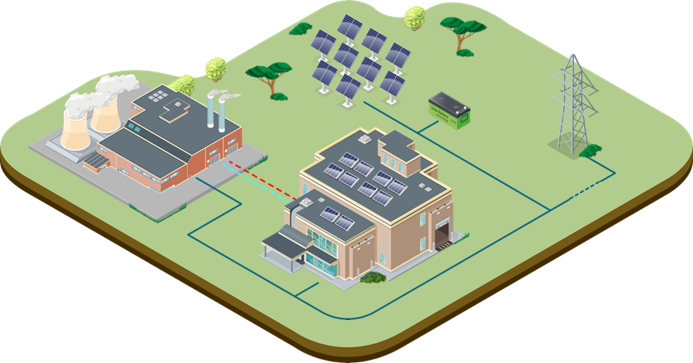
A microgrid is an energy supply network built around local power and heat generation facilities
Solar Energy will allow you to generate clean and cost effective electricity
Generate savings by limiting or optimizing your electricity purchases from the grid
Designed to operate autonomously or in synchronization with a larger grid within a clearly defined area and typically include:
Renewable energy sources (solar, wind or biomass)
Fossil fuel energy sources to ensure grid stability
Energy storage solutions (batteries, hydrogen storage, mechanical storage, etc.)
A low-voltage supply grid regulated by a smart control system
Localized CHP plant can provide electricity to the plant as well as heating and cooling
Smart energy management can optimize loads and generate revenues from utility programs
Energy storage can take advantage of energy arbitrage opportunities and reduce charges from the grid
Notes:
Microgrids are different from solar + storage in that microgrids are a grouping of interconnected loads within a clearly defined grid boundary (DOE def) that are optimized for managing generation, storage,

Slide 13
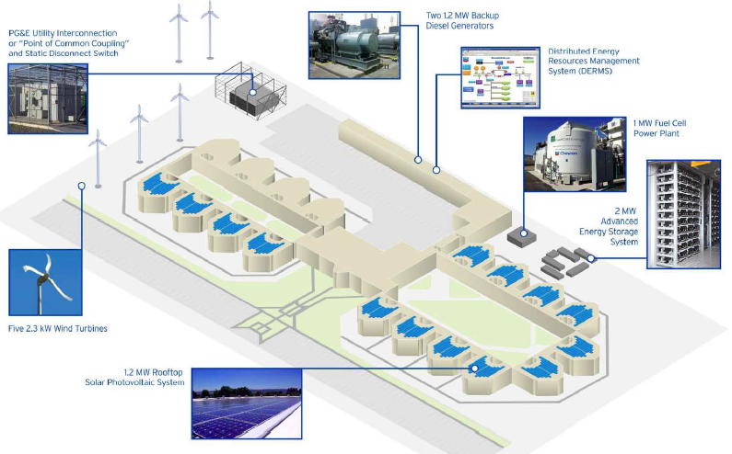
Alameda County Santa Rita Jail Microgrid
Project Highlights
Integrates renewable, distributed generation to provide improved site resilience, lower emissions and reduce costs
Reduced electricity spend by approx. 70%
Reduced water / sewage spend by approx. 50%
$2.5MM
in annual energy / water savings
1.2 MW of solar PV
1 MW fuel cell
2 MW / 4 MWh BESS
Hot Water Boiler Plant Renovations
Notes:
One example of an ENGIE microgrid in CA
Part of a DOE grant project, special interconnection process was required,
Jails are one of 5 critical facility customer classes that are required to have backup power by law. Others are fire, police, emergency response call centers, and hospitals.
Customer motivation driven by regulation, desire to save on energy costs, desire to be more sustainable, need to be more resilient
Santa Rita is considered the greenest jail in the U.S.
we want to replicate this in all schools, hospitals, water treatment facilities, fire stations, etc.

Slide 14
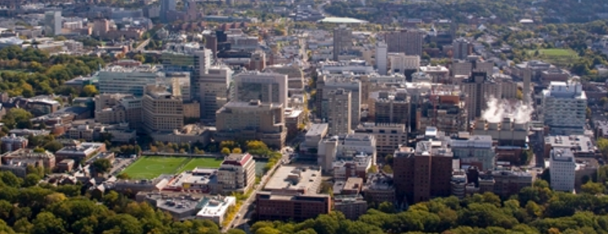
Longwood Medical Center Energy System
PROJECT HIGHLIGHTS
Microgrid and District Energy system serving a campus with 74 buildings occupying 12 million sq. ft
Delivers efficient and reliable energy to six Harvard-affiliated healthcare institutions
99 MW
microgrid
Steam Capacity: 1,000,000 lbs/hr
Chilled Water Capacity: 41,000 tons

